Slide 1





Java MVC Frameworks
The Right Way: Control Flow
Java MVC Frameworks
SoftUni Team
Technical Trainers
Software University
http://softuni.bg
Notes:
© Software University Foundation – http://softuni.org
This work is licensed under the Creative Commons Attribution-NonCommercial-ShareAlike license.
<number>

Slide 2



Table of Contents
<number>

Slide 3
Questions
sli.do #java-web

Slide 4





Control Flow
General Knowledge
<number>

Slide 5

Exception Handling
<number>

Slide 6
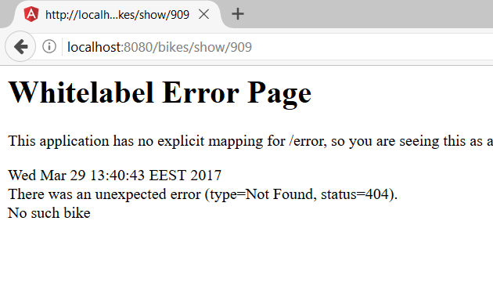
No such bike
Problem
<number>

Slide 7
Custom Exception
BikeNotFoundException.java
Status Code
Exception Message
@ResponseStatus (value = HttpStatus.NOT_FOUND, reason = "No such bike")
public class BikeNotFoundException extends RuntimeException {
}
Runtime Exception
BikeServiceImpl.java
Bike bike = this.bikeRepository.findOne(id);
if(bike == null){
throw new BikeNotFoundException();
}
Throw Exception
<number>

Slide 8
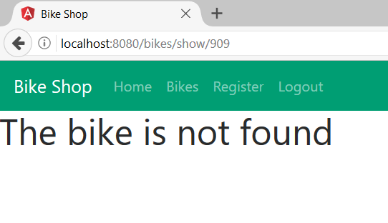
Exception Handling
BikeController.java
Exception Handling
@ExceptionHandler(BikeNotFoundException.class)
public ModelAndView bikeNotFound(ModelAndView modelAndView){
modelAndView.setViewName("bike-not-found");
return modelAndView;
}
Exception Message
<number>

Slide 9
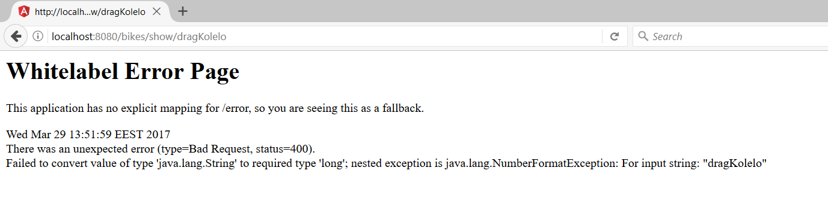
No such bike
Problem 2
<number>

Slide 10
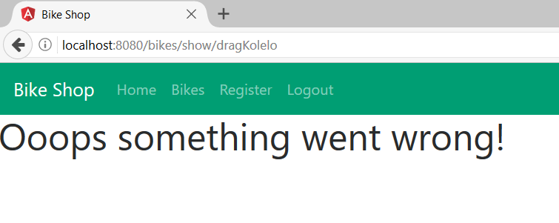
Global Exceptions
GlobalExceptionController.java
Global Exception Handling
@ControllerAdvice
public class GlobalExceptionController {
@ExceptionHandler(Exception.class)
public ModelAndView getException(ModelAndView modelAndView){
modelAndView.setViewName("bike-not-found"); return modelAndView;
}
}
Handles All Exceptions
Returns custom page
<number>

Slide 11

Pagination
<number>

Slide 12
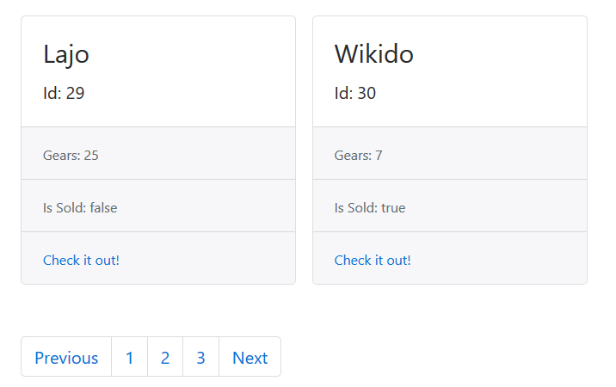
Problem
<number>

Slide 13
Pagination (1)
BikeRepository.java
@Repository
public interface BikeRepository extends PagingAndSortingRepository<Bike, Long> {
}
Pagination Repository
BikeServiceImpl.java
@Override
public Page<BikeViewModel> listAllByPage(Pageable pageable) {
Page<Bike> bikePage = this.bikeRepository.findAll(pageable);
…
}
Page
<number>

Slide 14
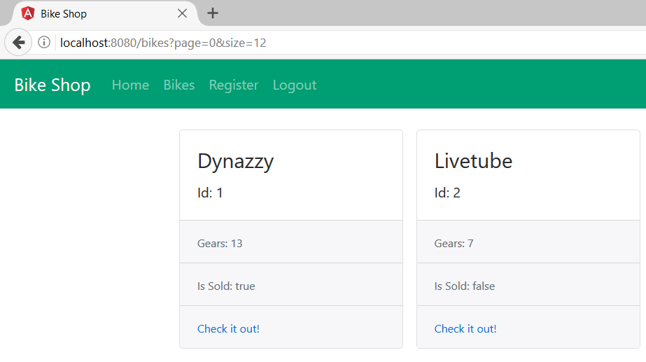
Pagination (2)
BikeRepository.java
@GetMapping("/bikes")
public String getBikes(Model model,
@PageableDefault(size = 10)Pageable pageable){
}
Pageable Instance (has Page and Size)
Page and Size
<number>

Slide 15


Summary
Control Flow – doing things, the right way!
Error Handling
Spring’s easy error handling @ExceptionHandler
Pagination
Formatting data, elegantly.
<number>

Slide 16







Java MVC Frameworks – Architecture
https://softuni.bg/courses/java-mvc-frameworks-spring
Notes:
© Software University Foundation – http://softuni.org
This work is licensed under the Creative Commons Attribution-NonCommercial-ShareAlike license.
<number>

Slide 17
License
This course (slides, examples, demos, videos, homework, etc.) is licensed under the "Creative Commons Attribution-NonCommercial-ShareAlike 4.0 International" license
<number>
Notes:
© Software University Foundation – http://softuni.org
This work is licensed under the Creative Commons Attribution-NonCommercial-ShareAlike license.
<number>

Slide 18





Trainings @ Software University (SoftUni)
Software University – High-Quality Education, Profession and Job for Software Developers
softuni.bg
Software University Foundation
http://softuni.foundation/
Software University @ Facebook
facebook.com/SoftwareUniversity
Software University Forums
forum.softuni.bg
Notes:
© Software University Foundation – http://softuni.org
This work is licensed under the Creative Commons Attribution-NonCommercial-ShareAlike license.
<number>

